Slide 1
HyperGraph Neural Networks
Written by: Feng et al.
Presented by Shawn Catudal

Slide 2

Overview
Background
HyperGraph Neural Networks
Experiments
Results
Conclusion

Slide 3
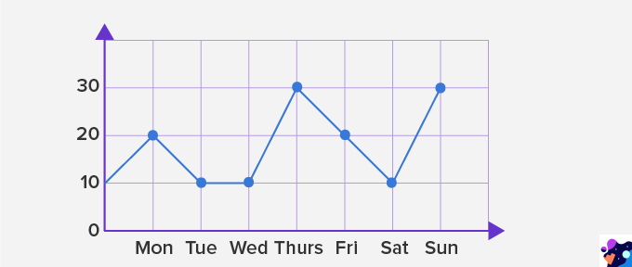
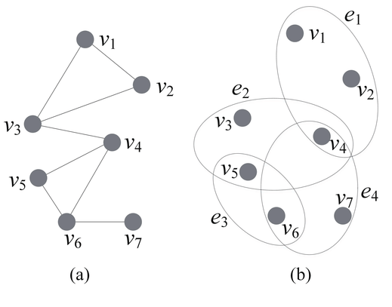
Background
Graph Based Neural Networks have been gaining popularity
Able to encode graph structure of different inputs
Have shown Superiority on representation learning
Representation learning is about learning features from raw data that effectively represent data in a useful way
Graphs vs HyperGraphs
Traditional Graphs cannot portray more complex data.
Only pairwise interactions (link)
Edge vs hyperedge
Not well suited for multi model
Visual, text and social connections
Hypergraphs are a generalization of graphs
Can have hyperedges that connect any number of nodes

Slide 4
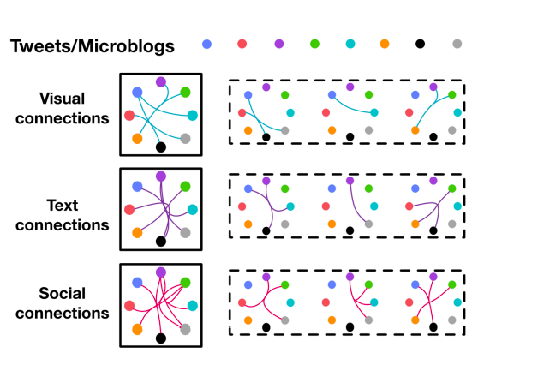
Background
Example:
Social Media Connections
Friends
Likes
Posts
Becomes very complex with scale
Hypergraphs allow for relationship between the different types of data
However, due to complexity, hypergraphs in machine learning are computationally very expensive
Limits application

Slide 5
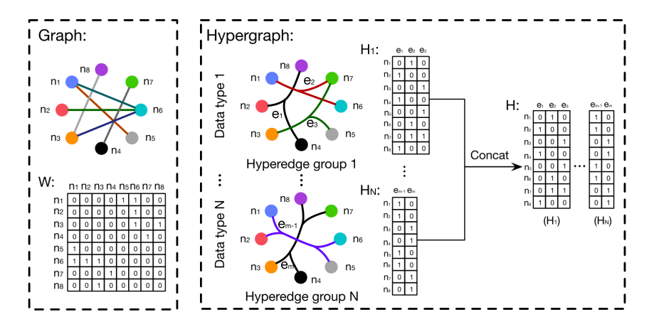
Background
Hypergraph/Graph Representation
Adjacency matrix vs. Incidence matrix
node x node for traditional graph adjacency matrix
node x edge for hypergraph incidence matrix

Slide 6

Goals of this paper
Propose Hypergraph Neural Network framework for data representation learning
Design a better convolution operation
Ability to incorporate multimodal data
Show improved results compared state of the art

Slide 7
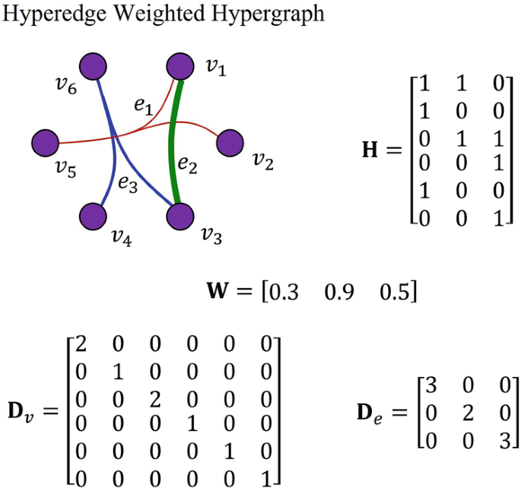


Hypergraph Matrices
Hypergraph is defined as
is vertex set
is hyperedge set
is diagonal weight matrix for the hyperedges
The Hypergraph can be denoted by a incidence matrix with entries:
Degree of vertex defined as
Degree of edge defined as
D_{e} and D_{v} are diagonal matrices of respective degree

Slide 8
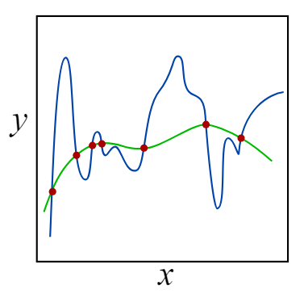



Hypergraph Node-Vertex Classification
Regularization
Node Vertex Classification Problem
Node labels should be “smooth” on hypergraph
R_{emp}(f) is supervised empirical loss
Ω(f) is regularization term
f(.) is classification function

Slide 9



Hypergraph Node-Vertex Classification
Let:
𝚯 is basically the structure of the graph, including weights
𝝙 is the hypergraph Laplacian
Positive semi-definite
The Laplacian reflects the structure of the hypergraph
Normalized regularization term can then be written as

Slide 10
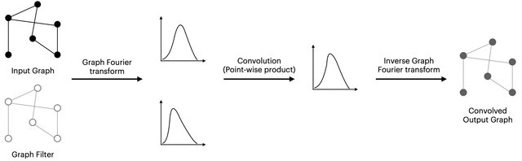
Spectral Convolution
Graphs and Hypergraphs have an irregular shape
Unlike images or video with grid like shapes
High level overview:

Slide 11

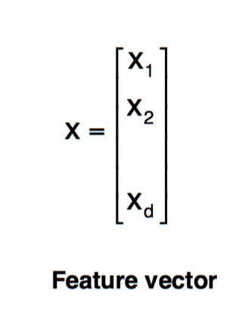
Spectral Convolution
is a hypergraph with n vertices
𝝙 is a n x n positive semi-definite matrix
is then the eigen decomposition
𝚽 is matrix of eigenvectors
𝝠 is diagonal matrix of eigenvalues
is a signal or features

Slide 12
Spectral Convolution
Eigenvectors are regarded as the Fourier bases and eigenvalues are interpreted as frequencies.
Is the Fourier transform of the signal x
Spectral convolution of signal x and filter g
is the element-wise Hadamard product
is a function of fourier coefficients
However this computation cost of the forward and inverse fourier transforms are very high making it not ideal. Moving on...

Slide 13
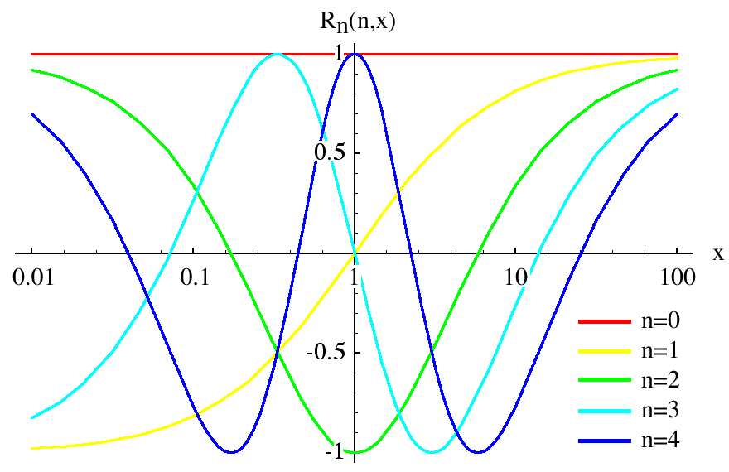


Hyperedge Convolution
Parametrize with k order polynomials
Truncated Chebyshev polynomials
Limit k to 1
Convolution parameterized as follows
Scaled Laplacian

Slide 14

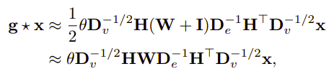

Hyperedge Convolution
Further Simplification of convolution operation
𝚯 is the parameter learned during training
Y is the output of the convolution
Similar to a feature map in standard convolution

Slide 15
Equation explained
Normalization
Output of Convolution
Filter with learned Parameters
Structure. Applies weights to nodes and edges
Features

Slide 16
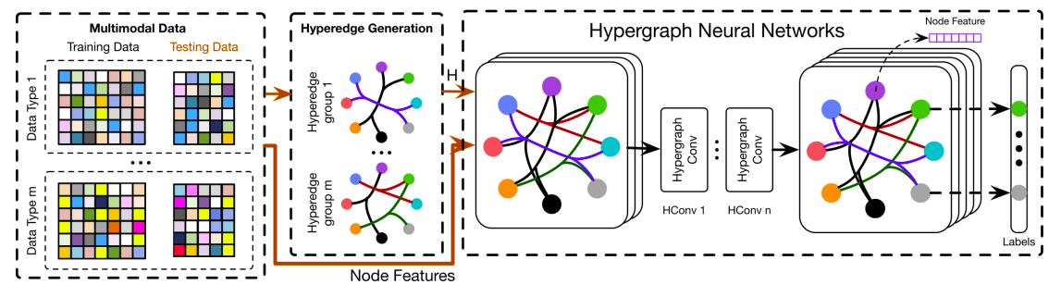
Multiple hyperedge groups are constructed from data
H and node features fed into HGNN
Resulting transformed hyperedge features
Multi-modality datasets divided into training and test
Hyperedge groups are concatenated and form hypergraph adjacency matrix H
Convolution on hypergraph to extract higher order correlations
Resulting label from classification of each node

Slide 17
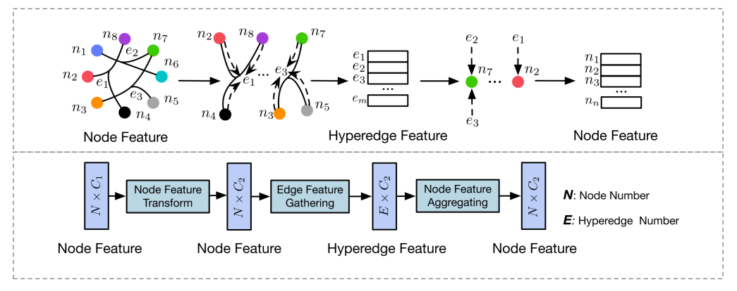

Hyperedge convolution layer

Slide 18
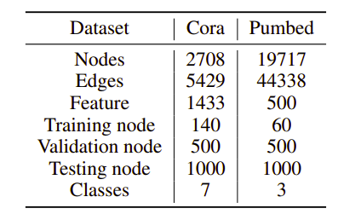
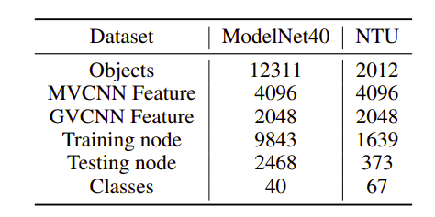
Datasets for Experiments
Task 1
Classify citation data
Feature for each data is bag-of-words representation of the documents
Task 2
Classify visual objects
Datasets are of 3d objects.

Slide 19
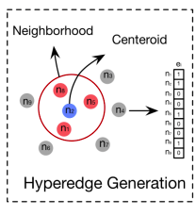
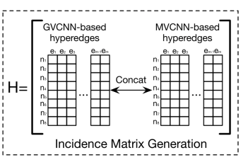
Experiments
Two tasks
1. Citation Network Classification
Use two-layer HGNN
Feature dimension of hidden layer is 16
ReLU as nonlinear activation function
Adam optimizer to minimize cross entropy loss
2. Visual object recognition
Hypergraph built according to distance between two features
Hyperedges formed based on k-nearest neighbor of vertices
Features are extracted using MVCNN and GVCNN and then concatenated
Compare to state of the art

Slide 20
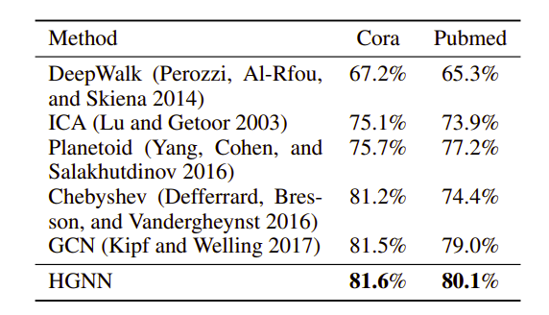
Results of Citation Network classification

Slide 21
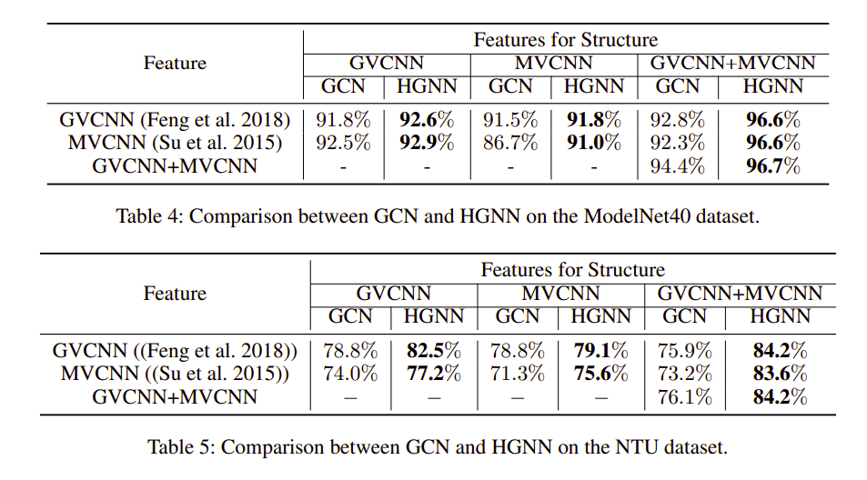
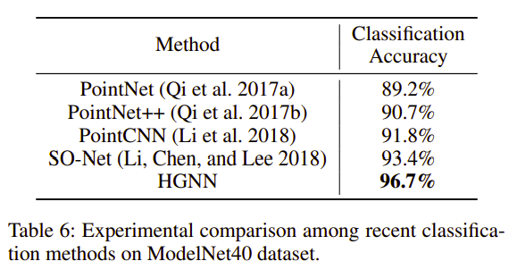
Results of Visual object Classification

Slide 22

Discussion
Proposed HGNN method outperforms state of the art methods on specified datasets
Citation network saw slight improvements
This is due to the generated hypergraphs being quite similar to the regular graph structure
Visual object recognition task saw significant improvement
4.8% and 3.2% over PointCNN and SO-Net
Improvements over GCN as well of up to 10.4%

Slide 23

Conclusion
Proposed a framework for Hypergraph Neural Network (HGNN)
Generalizes the convolution operation to hypergraphs
Spectral convolution is parameterized and truncated
HGNN is more general framework which can handle the complex and high order correlations through hypergraphs for representation learning
Experiments show improvements in several aspects over state of the art and GCN

Slide 24
Questions?
Thanks :)

